Slide 1
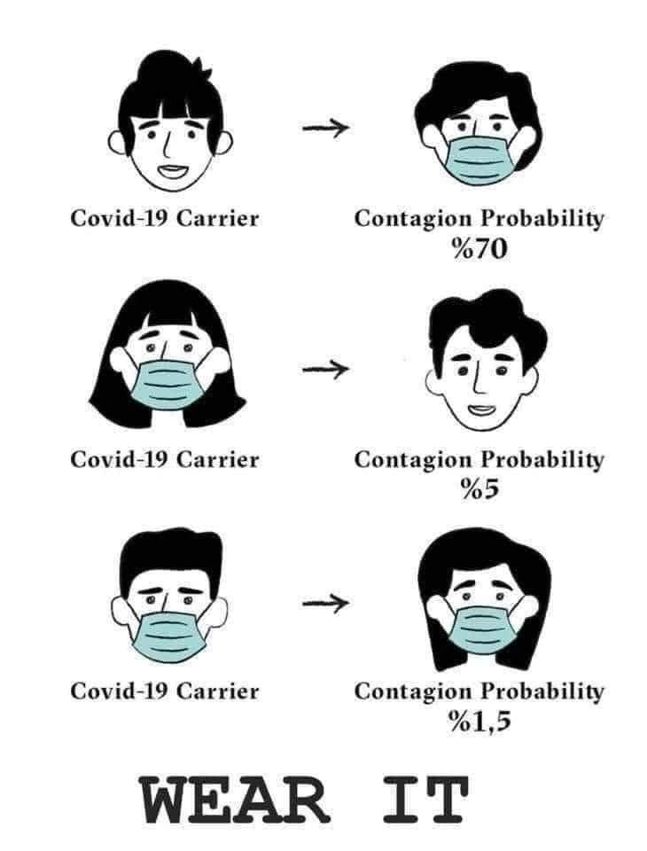
Always wear a mask, ensure it covers your nose, mouth, and chin, and that you pinch the nose

