Slide 1
Emergency Procedure – Cardiopulmonary Resuscitation

Slide 2
Policy Statement
Personnel have completed training on the initiation of cardiopulmonary resuscitation (CPR) and basic life support (BLS) for victims of sudden cardiac arrest.

Slide 3
General Guidelines
Sudden cardiac arrest is a loss of heart function due to abnormal heart rhythms (arrhythmias). Cardiac arrest occurs soon after symptoms appear. It is a leading cause of death among adults.
A “heart attack” refers to impaired blood flow to the heart which leads to damage of the heart muscle. A heart attack can cause sudden cardiac arrest. Typically heart attacks are less sudden than SCA.
Victims of cardiac arrest may initially have gasping respirations or may appear to be having a seizure. Training in BLS includes recognizing presentations of SCA.
The chances of surviving SCA may be increased if CPR is initiated immediately upon collapse.
Early delivery of a shock with a defibrillator plus CPR within 3-5 minutes of collapse can further increase chances of survival.

Slide 4
General Guidelines
If an individual (resident, visitor, or staff member) is found unresponsive and not breathing normally, a licensed staff member who is certified in CPR/BLS shall initiate CPR unless:
It is known that a Do Not Resuscitate (DNR) order that specifically prohibits CPR and/or external defibrillation exists for that individual; or
There are obvious signs of irreversible death (e.g., rigor mortis).
Advance Directive wishes will be verified through review of the executed POLST Form or other designated form that can be found in the POLST Binder alphabetically at the Nurses station for easy quick access and in the on the residents PCC dashboard under code status. If the resident’s DNR status is unclear, CPR will be initiated until it is determined that there is a DNR form that has been executed.
If the first responder is not CPR-certified, that person will call for help within the facility and call 911 and follow the 911 operator’s instructions until a CPR-certified staff member arrives.

Slide 5
Preparation for Cardiopulmonary Resuscitation
Obtain and/or maintain American Red Cross or American Heart Association certification in Basic Life Support (BLS)/Cardiopulmonary Resuscitation (CPR) for at least 2 key staff members who will direct resuscitative efforts, including non-licensed personnel.
Maintain equipment and supplies necessary for CPR/BLS in the facility at all times, crash cart is located at the Nurses station.
Provide information on CPR/BLS policies and advance directives to each resident/representative upon admission.

Slide 6
Emergency Procedure – Cardiopulmonary Resuscitation
If an individual is found unresponsive, briefly assess for absence of breathing and heart rate. If sudden cardiac arrest is likely, begin CPR:
Quickly verify or instruct another staff member to verify DNR or code status of the individual.
Instruct a staff member to or activate the emergency response system (Code Blue) (This communication can be done by walkie talkie or telephone paging system depending on community at AG and AC dial #30 on the phone for an all phone page), call 911, grab crash cart and AED if setting has this.
Initiate the basic life support (BLS)/ Cardiopulmonary resuscitation (CPR) sequence of events.
Continue with CPR/BLS until emergency medical personnel arrive
When the EMS Team arrives they will take over and ask for any assistance they need from you

Slide 7
AED- Automated External Defibrillator Usage
Automated external defibrillators can help save lives during sudden cardiac arrest. However, even after training, remembering the steps to use an AED the right way can be difficult. In order to help keep your skills sharp, American Red Cross created a quick step-by-step guide. This way, you can review the AED steps any time, at your convenience, and keep them fresh in your memory.

Slide 8
AED- Automated External Defibrillator Usage
Before Using the AED
These AED steps should be used when caring for a non-breathing child aged 8 or older who weighs more than 55 pounds, or an adult.
After checking the scene and ensuring that the person needs help, you should ask a bystander to call 911 for help, then:

Slide 9
AED- Automated External Defibrillator Usage
1 Turn on the AED and follow the visual and/or audio prompts.
2 Open the person's shirt and wipe his or her bare chest dry. If the person is wearing any medication patches, you should use a gloved (if possible) hand to remove the patches before wiping the person's chest.
3 Attach the AED pads, and plug in the connector (if necessary).
4 Make sure no one is, including you, is touching the person. Tell everyone to "stand clear."
5 Push the "analyze" button (if necessary) and allow the AED to analyze the person's heart rhythm.
6 If the AED recommends that you deliver a shock to the person, make sure that no one, including you, is touching the person – and tell everyone to "stand clear." Once clear, press the "shock" button.
7 Begin CPR after delivering the shock. Or, if no shock is advised, begin CPR. Perform 2 minutes (about 5 cycles) of CPR and continue to follow the AED's prompts. If you notice obvious signs of life, discontinue CPR and monitor breathing for any changes in condition.

Slide 10
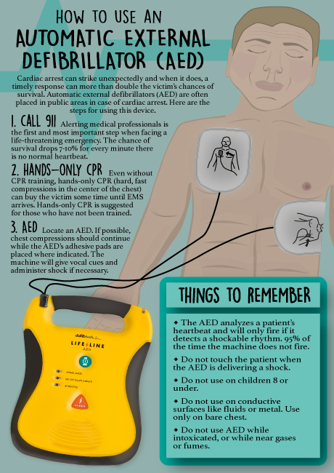

Slide 11
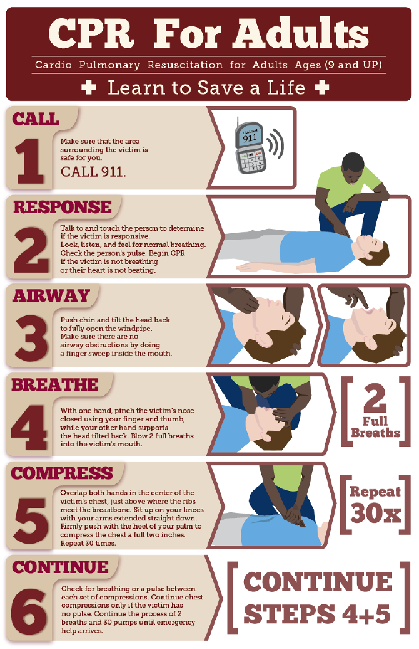

Slide 12
Code Blue Run Sheet
Resident Name Time Noted without heartbeat or respirations
Time Code status verified Time Compressions/Rescue Breathing Started
Time 911 notified IV started Site Size
Fluids/type of fluids started Rate Time intubated/airway inserted
Time EMS arrived Time EMS left facility with patient
Time of death if pronounced by EMS Time police arrived
Time MD notified Time POA/Family notified
Name of Hospital transferred to Name of funeral home transferred to (if applicable)
Time Coroner notified (if applicable) Time Funeral Home notified (if applicable)
Time Funeral Home arrived at facility (if applicable)
Last time patient was seen by staff and condition of patient at that time
Names of staff involved in code:
Time DON notified Time Administrator notified Notify DON and Administrator of any Code Blue when able. Contact DON prior to documenting code blue to ensure all required documentation is in the note.

